Slide 1
Mechanical Diagrams & Wiring Schematics
Why are they needed?

Slide 2
Lessons Learned

Slide 3
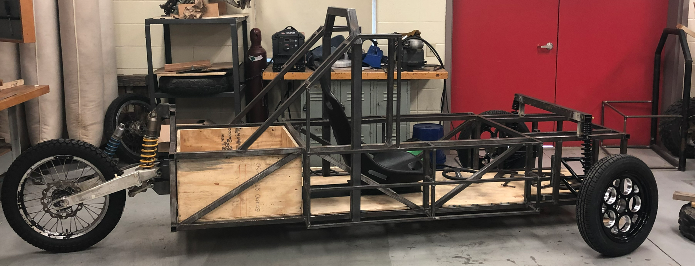
Poor/No Mechanical Drawings Result in…
Constantly in a “build-rebuild” cycle.
Significant increase in frustration level for all.
Significant loss of time and resources.
Many very late nights/mornings!
Reduction in quality.
Etc. Etc. Etc…………………
***…extremely poor efficiency!***

Slide 4
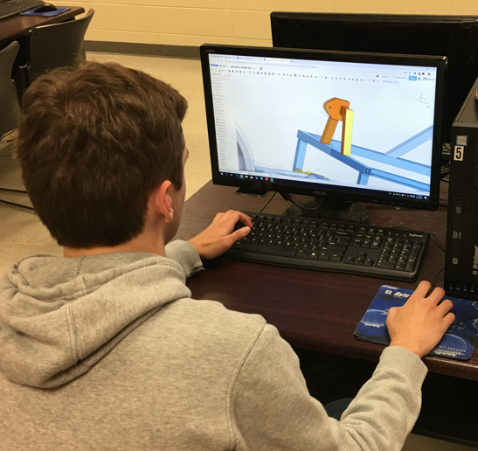
Quality Mechanical Drawings Improve…
Design and Assembly
Cost Savings and Quality
Safety, Maintenance, and Compliance
Communication and Coordination
Testing and Design Optimization
Supply Chain Management

Slide 5
Design and Assembly
Quality mechanical CAD drawings and wiring diagrams provide:
Accurate and detailed information about the design and layout of the car's components, which is critical for ensuring that the car is built required specifications.
Improves assembly efficiency and reduces the risk of errors and delays (Division of Labor).

Slide 6
Cost Savings and Quality
Having accurate and detailed mechanical CAD drawings and wiring diagrams:
Can help reduce the cost of building a solar car by reducing the need for rework.
Assists in ensuring that the car is built to the highest standards of quality and performance.

Slide 7
Safety, Maintenance, and Compliance
Quality mechanical CAD drawings and wiring diagrams can:
Help ensure that the car is built safely, by providing detailed information about the location and operation of safety-critical components, such as brakes, steering systems, electrical, etc.
Make it easier to maintain the car, by providing detailed information about the location and operation of various components, as well as instructions for performing routine maintenance tasks.
Help ensure that the car is compliant with relevant regulations and standards, by providing detailed information about the design and layout of the car's components.

Slide 8
Communication and Coordination
Quality mechanical CAD drawings and wiring diagrams:
Serve as a common reference point for the team, helping to facilitate effective communication and coordination between team members, advisors, and industry partners.

Slide 9
Test and Design Optimization
Quality mechanical CAD drawings and wiring diagrams can:
Help to test and validate the car, by providing detailed information about the design and layout of the car's components and allowing the team to easily identify any issues that may need to be addressed.

Slide 10
Supply Chain Management
Quality mechanical CAD drawings and wiring diagrams can:
Be used to plan and manage the procurement of materials and parts, by providing detailed information about the components required to build the car.

Slide 11
A Few Examples

Slide 12
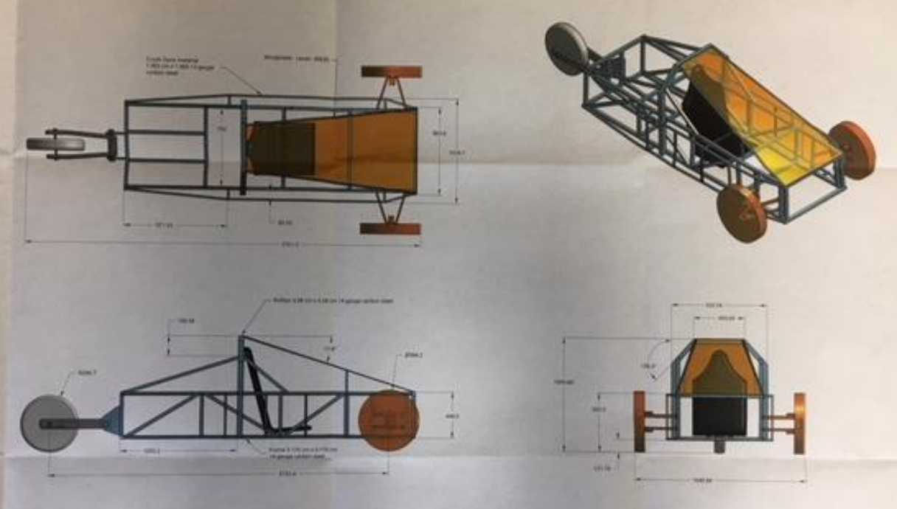
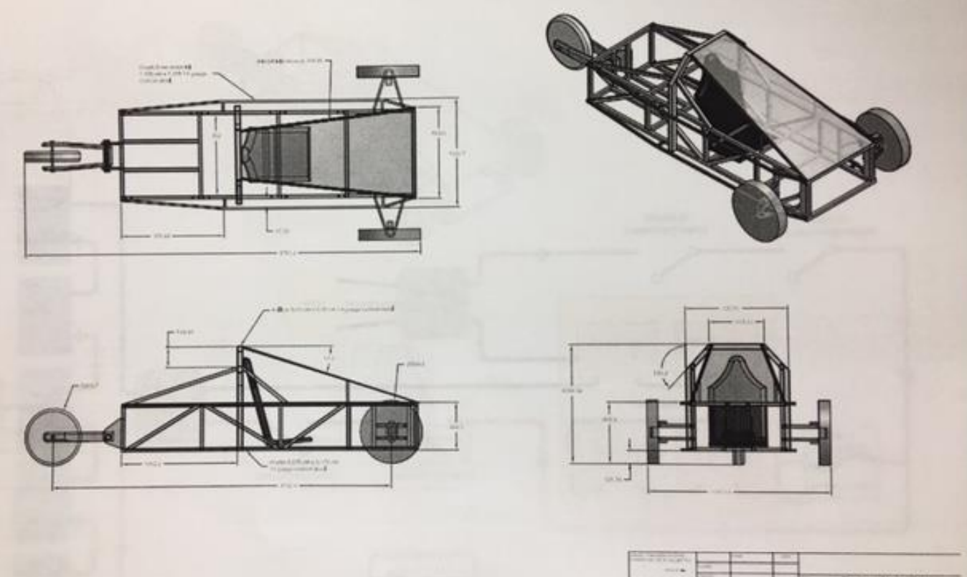
Bare-Basics (Far short of ideal)

Slide 13
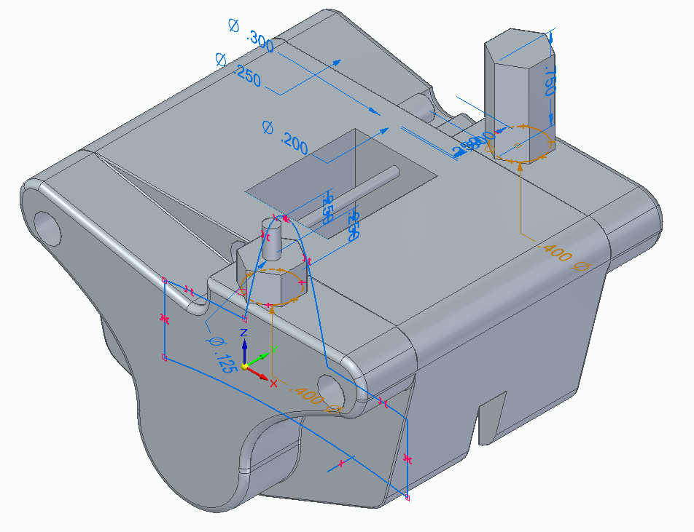
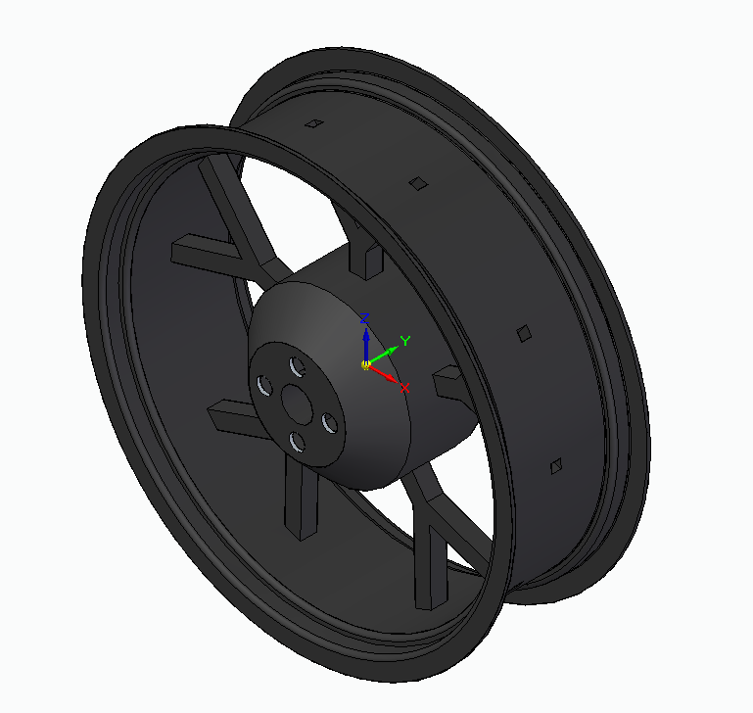
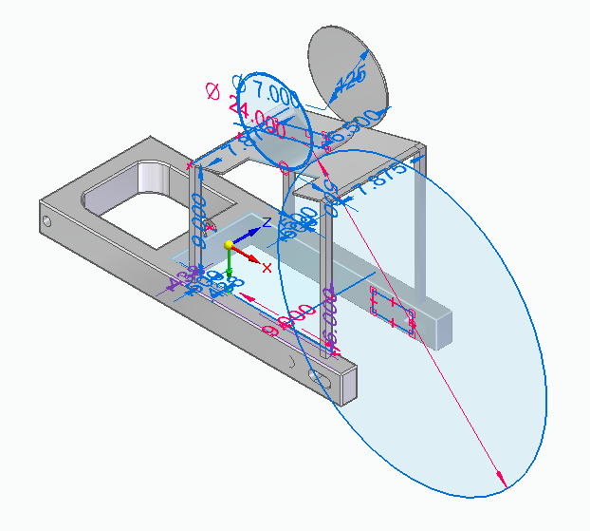
Detailed Individual Parts Used in CAD Assembly

Slide 14
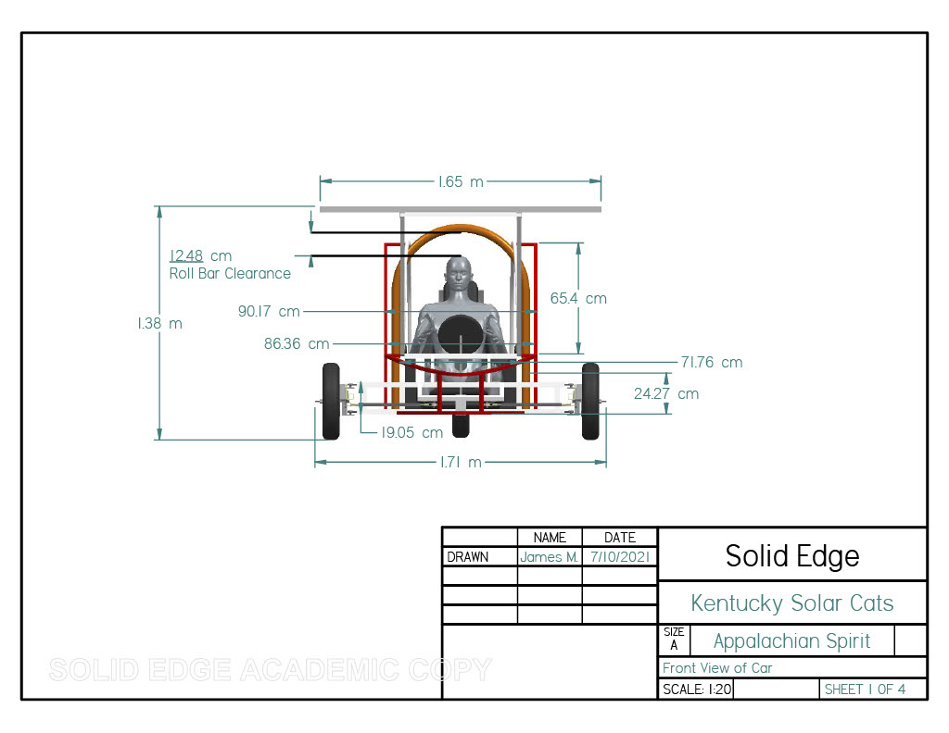
Front View Example

Slide 15
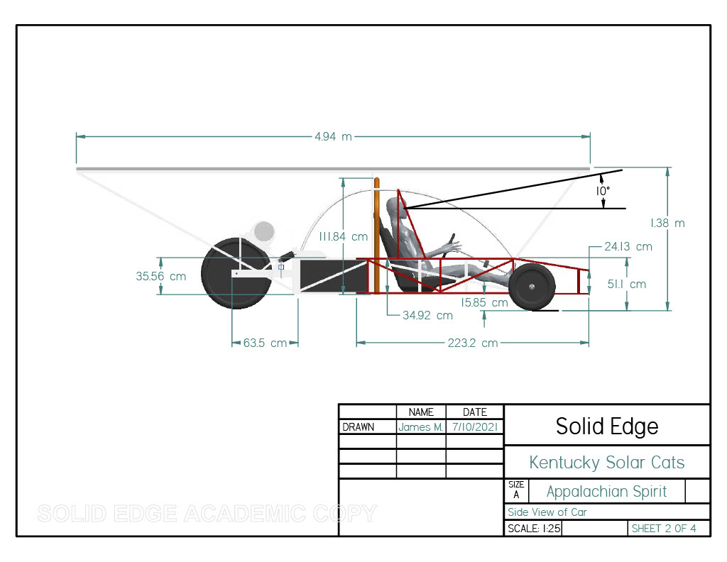
Side View Example

Slide 16
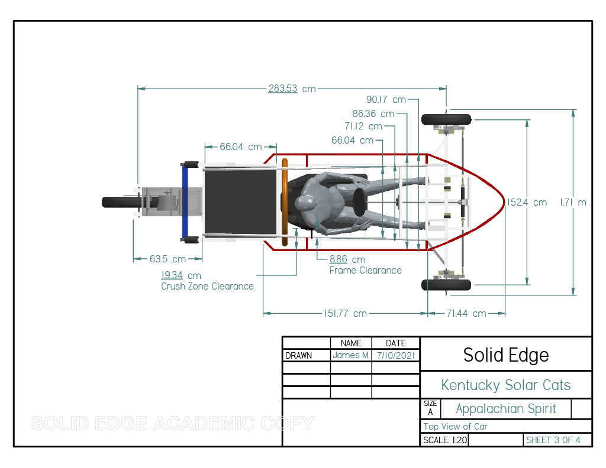
Top View Example

Slide 17
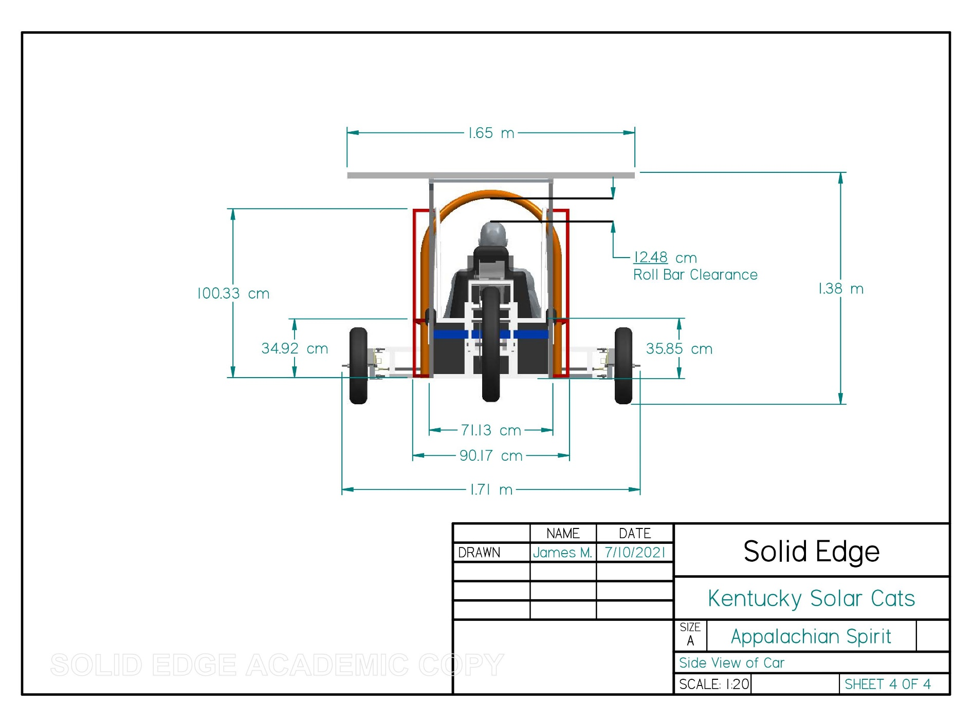
Rear View Example

Slide 18
Wiring Diagrams
Keeping everyone safe and knowledgeable

Slide 19
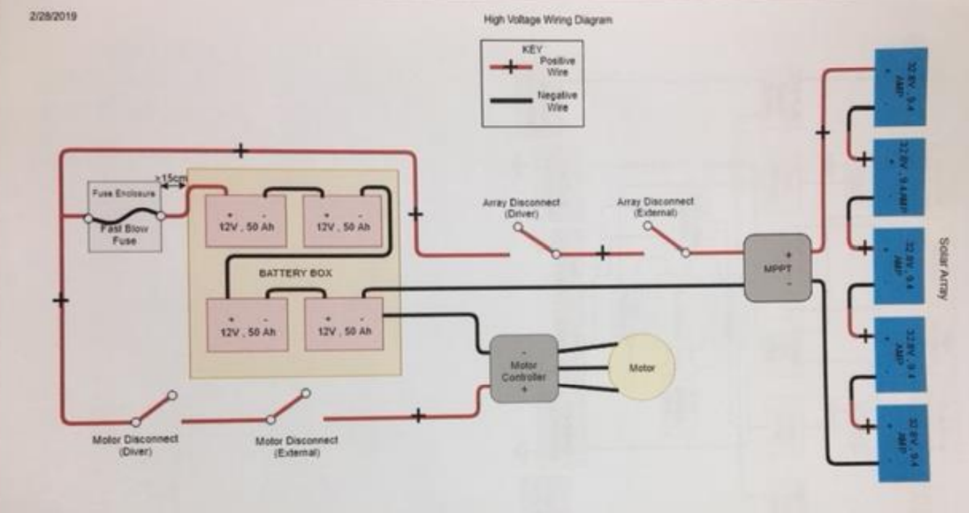
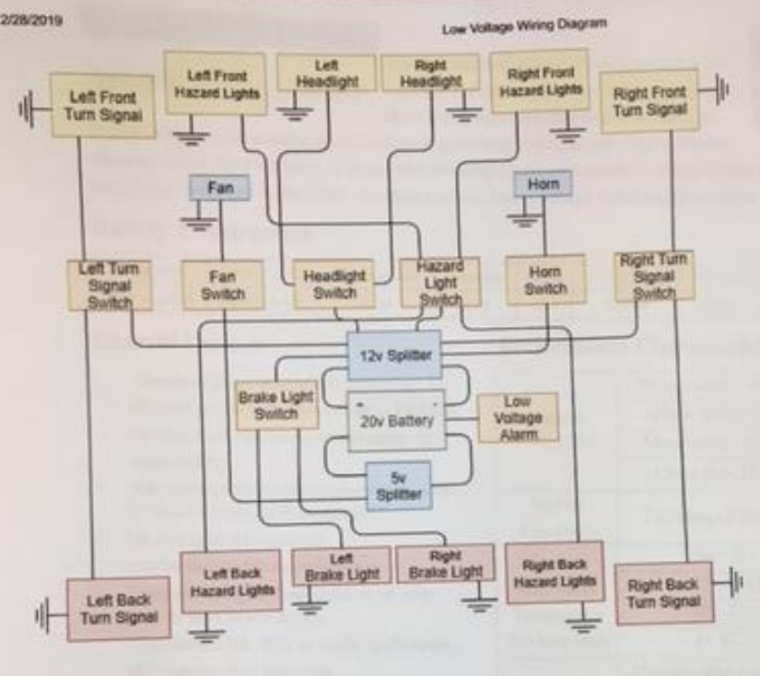
Meh. (May not be overly helpful)

Slide 20
Sample Low Voltage Wiring Diagram

Slide 21
Sample High Voltage Wiring Diagram

Slide 22
Thank you! Questions/Comments?
Contact Info:
Brian Coleman – 606.923.9444 – coleman.briank@gmail.com

